Slide 1


Why a Pharmacist?
Comprehensive Medication Management
For heart, kidneys, and metabolic conditions.
Pharmacists are medication experts with advanced training in disease management. They work collaboratively with other healthcare professionals to manage the complex interactions between medications, your body, and your health conditions.
One team. One plan. All your needs.
What to Expect
How to Get Started
Your visit may include:
Problem-Solving Discussions
Medication Review
Health & Lab Review
Personalized Plan Creation
Lifestyle change recommendations
Collaboration with your Healthcare Team
Ask your healthcare team about Comprehensive Medication Management!
Service may be available at no cost to you depending on health insurance.

Slide 2

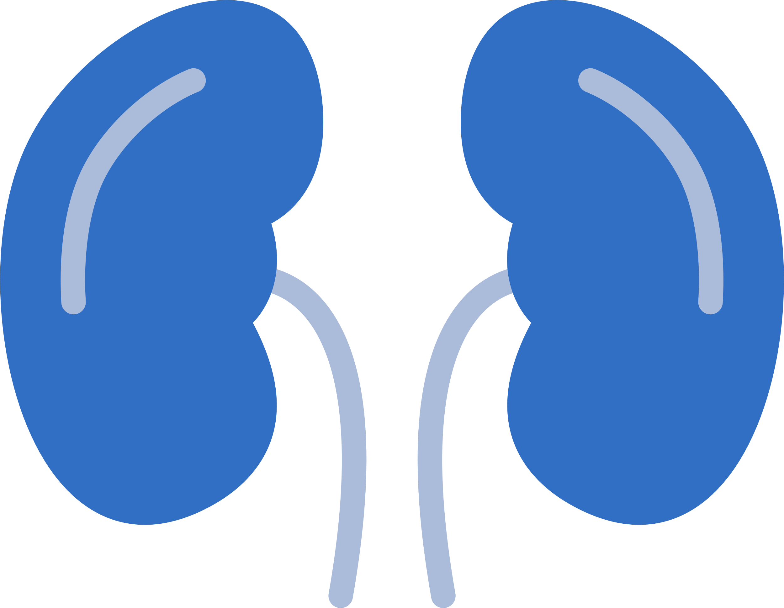



When conditions are connected, your care should be too.
What is Comprehensive Medication Management?
Why Is CMM Important?
Comprehensive Medication Management (CMM) is a pharmacist-led service that focuses on making sure all your medications are working their best for you.
Heart disease, kidney disease, diabetes, and weight-related conditions are closely connected.
CMM helps your medications work together, not against each other.
That means:
  Medications for one condition can affect another
  Kidney function can change how medications work
  Side effects and drug interactions are more common
How CMM Helps You Reach Your Goals
Your pharmacist reviews:
  Prescriptions
  Over-the-counter medications
  Vitamins and supplements
Do your medications work for you?
CMM focuses on your personal goals, such as:
  Staying out of the hospital
  Minimizing medication side effects
  Taking fewer or simpler medications
  Having fewer medical visits
Each medication is checked to ensure it is:
  Right for your condition(s)
  Working as intended
  Safe for your heart, kidneys, and blood sugar
  Easy for you to take

